Slide 1
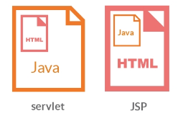
JSP (Java Server Pages)
Java Server Pages(JSP) technology enables you to mix regular,
static HTML with dynamically generated content.
JSP is an API of J2EE that helps us to accept the request over the network and generate dynamic response.
JSP helps us to separate business logic from presentation logic.

Slide 2
JSP capable servers
Tomcat from Apache
WebLogic from BEA Systems (JSP, Servlets and EJBs)
WebSphere from IBM (JSP, Servlets and EJBs)

Slide 3
The Need for JSP
Drawbacks of Servlets
- It is hard to write and maintain the HTML
You cannot use standard HTML tools/Editors
(Dreamweaver, MS Expression Web, Google Web designer, Kompozer, MS FrontPage)
- The HTML is inaccessible to non-Java developers

Slide 4
Benefits of JSP
It is easier to write and maintain the HTML
You can use standard web-site development tools
You can divide up your development team
Other Advantages
JSP are translated and compiled into JAVA servlets but are easier to develop than JAVA Servlets
JSP have all advantages of Java i.e write once run anywhere
JSP uses simplified scripting language based syntax for embedding HTML into JSP.
JSP containers provide easy way for accessing standard objects and actions.

Slide 5
JSP reaps all the benefits provided by JAVA servlets and web container environment, but they have an added advantage of being simpler and more natural program for web enabled enterprise developer.
JSP use HTTP as default request /response communication paradigm and thus make JSP ideal as Web Enabling Technology.

Slide 6
Advantages of JSP over other technologies
Versus .NET and ASP
JSP is portable to multiple operating systems and Web servers
JSP is more powerful and better suited to complex applications that require reusable components.
Versus PHP
Dynamic part of JSP is written in Java which already has API for networking, database access, distributed objects etc.
JSP is much more widely supported by tool and server vendors than is PHP.

Slide 7
Versus Pure Servlets
Convinient to write regular HTML than to use too many println statements to generate HTML.
Different people can work on different tasks. JSP developers need to know servlets -
1) JSP pages get translated into servlets
2) JSP consists of static HTML, special purpose JSP tags and Java code
3) Servlets are better in some scenarios and JSP's are better in others.
4) Some tasks are better accomplished by a combination of servlets and JSP.

Slide 8
Versus JavaScript
Its a complementary technology to JSP
Choosing a Technology -
Standardization
Portability
Integration
Industry support
Technical Features

Slide 9
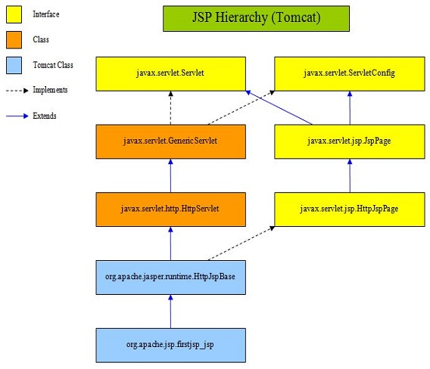

Slide 10
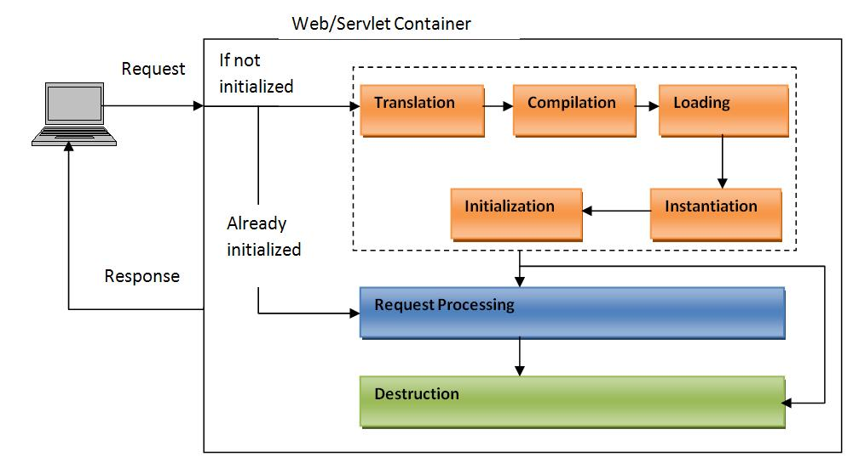
JSP Lifecycle

Slide 11
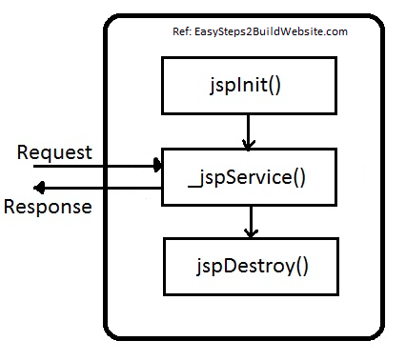

Slide 12
JSP - > Servlet
Every JSP gets translated to Servlet and it can be found at
<path_to_workspace>/.metadata/.plugins/org.eclipse.wst.server.core/tmp0/<server_domain_name>/work/<project_name>/jsp_servlet/
[OR]
<Tomcat location>\work\Catalina\localhost\<ApplicationName>\org\apache\jsp

Slide 13
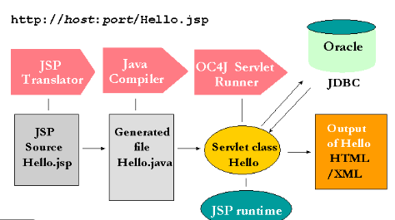
How is a JSP Served?

Slide 14
Basic Syntax
HTML Text
HTML Comments
JSP Comments - <%-- Hello --%>
JSP Expression - <%= Java Value %>
JSP Scriptlet - <% Java Statements %>
JSP Declaration - <%! Field/Method Definition %>

Slide 15
Basic Syntax
JSP Directive - <%@ directive attribute = “value” %>
JSP Action – jsp:action_name action_attributes
JSP Expression Language Element - ${EL expression}
Custom tag - <prefix:name> </prefix:name>
Escaped Template Text – Ex: <\% %\>

Slide 16
JSP Tags
Every JSP tag has its own functionality defined and each tag has its own specific purpose.
We cannot make use of one tag inside another.
What is template text?
Two minor exceptions to the “template text” processing –
a) <% or %> in the output
b) Comment to appear in the JSP page - <%--
--%>

Slide 17
Invoking Java Code from JSP
Usage of long and complicated blocks of Java code in JSP pages yields a result which is
Hard to maintain
Hard to debug
Hard to reuse
Hard to divide among different members in the development team.

Slide 18
Invoking Java Code from JSP
Call Java code directly
Call Java code indirectly(Utility classes)
Use beans
Use MVC architecture
Use JSP expression language
Use custom tags(tag handler classes)

Slide 19
Types of JSP Scripting Elements
Expressions
Syntax: <%= Java Expression %>
Allows us to print dynamic values to output stream
Code placed within this tag should NOT end with semi-colon.

Slide 20
Scriptlets
Syntax <% Java Code %>
Helps us to write any amount of valid Java code inside JSP
Code placed within this tag becomes part of _jspService() method.

Slide 21
Declarations
Syntax: <%! Field/Method Declaration %>
This tag allows us to declare variables, methods(non-abstract), inner classes or blocks(static or non-static).
Code placed within this tag will be present outside of _jspService() method of translated servlet. Hence if we declare a variable using this tag, it becomes class level variable.
We can write declaration tag anywhere in JSP.

Slide 22
Limiting the Amount of Java Code in JSP
Using separate Java class and invoking it with one or two lines inside JSP is better option. Y??
Development
Compilation
Debugging
Division of labor
Testing
Reuse

Slide 23
Using JSP Expressions
A JSP Expression is used to insert values directly into the output.
<%= Java Expression %>
The expression is evaluated, converted to a string and inserted in the page. This evaluation is done at runtime.
Ex: Current Time: <%= new java.util.Date() %>

Slide 24
Predefined Variables
They are nothing but “implicit objects” - There are 9 implicit objects
These are the objects that are created by the container automatically, so that developer need not explicitly create them.
These objects use the standard variable names and are available only in _jspService() method.

Slide 25
request – HttpServletRequest
response – HttpServletResponse
session – HttpSession
out – PrintWriter
application – ServletContext
config – ServletConfig
pageContext – High Performance JSPWriters
page - this
exception - Exception

Slide 26
JSP/Servlet Correspondence
JSP expressions basically become print (or write) statements in the servlet that results from the JSP page.
Regular HTML – print statement with double quotes
JSP expressions – print statements without double quotes

Slide 27
Sample JSP
<h1> A random number </h1>
<%= Math.random() %>
Resulting Servlet Code
public void _jspService(HttpServletRequest request, HttpServletResponse response) throws ServletException, IOException {
JspWriter out = response.getWriter();
out.println(“<h1> A random number </h1>”);
out.println(Math.random());
.......
}

Slide 28
Comparing Servlets to JSP Pages (ThreeParams example)
JSP Version is clearly superior: shorter, simpler and easier to maintain
JSP is best when structure of HTML is fixed but the values at various places need to be computed dynamically.
If the page consists of binary data or has less static content, servlets are better.

Slide 29
Writing Scriptlets
Any arbitrary or complex code will be part of scriptlet.
It becomes part of _jspService() method
<% Java code %>
Implicit objects can be accessed in scriptlet.
Ex: <%
String querydata = request.getQueryString();
out.println(“Attached GET data:” +querydata);
%>

Slide 30
Combination of Scriptlet and expression
<% String querydata = request.getQueryString(); %>
Attached GET data: <%= querydata %>
Single JSPSingle JSP Expression
Attached GET data: <%= request.getQueryString() %>

Slide 31
Scriptlets can be used to do many of the tasks including,
Setting response headers
Setting status codes
Writing to the server log
Updating database
Execute code that contains loops, conditionals or other complex constructs

Slide 32
JSP/Servlet Correspondence
Scriptlet code is directly inserted into the _jspService() method
Sample JSP
<H2> foo </H2>
<%= bar() %>
<% baz(); %>
Resulting Servlet Code
public void _jspService(HttpServletRequest request, HttpServletResponse response) throws ServletException, IOException {
response.setContentType(“text/html”);
HttpSession session = request.getSession();
JspWriter out = response.getWriter();
out.println(“<H2> foo </H2>”);
out.println(bar());
baz();
...
}

Slide 33
Example Programs
BGColor.jsp
Using Scriptlets to Make parts of the JSP Page Conditional
DayWish.jsp
1) code inside a scriptlet gets inserted into the resultant's servlet's _jspService() method
2) any static HTML(template text) before or after a scriptlet gets converted to print statements

Slide 34
Using Declarations
JSP Declaration lets us define methods and fields that get inserted into the main body of the servlet class( outside the _jspService())
<%! Field or Method Definition %>
JSP Declaration can contain field(instance variable) definitions, method definitions, inner class definitions or even static blocks.
Do not use JSP declarations to override the standard servlet life-cycle methods

Slide 35
For initializations and cleanup in JSP pages, use JSP declarations to override jspInit or jspDestroy
Define most methods with separate Java classes, not JSP declarations.

Slide 36
JSP/Servlet Correspondence
Ex: <H1> Some Heading </H1>
<%!
private String randomHeading() {
return(“<H2” +Math.random()+ “</H2>”);
}
%>
<%= randomHeading() %>

Slide 37
public class XXX implements HttpJspBase {
private String randomHeading() {
return(“<H2>” +Math.random()+ “</H2>”);
}
public void _jspService(HttpServletRequest request, HttpServletResponse response) throws ServletException, IOException {
response.setContentType(“text/html”);
HttpSession session = request.getSession();
JspWriter out = response.getWriter();
out.println(“<H1> Some Heading </H1>”);
out.println(randomHeading());
..
}
}

